Slide 1
Gastritis peptic ulcer
Isbandiyah dr SpPD
FKUMM

Slide 2
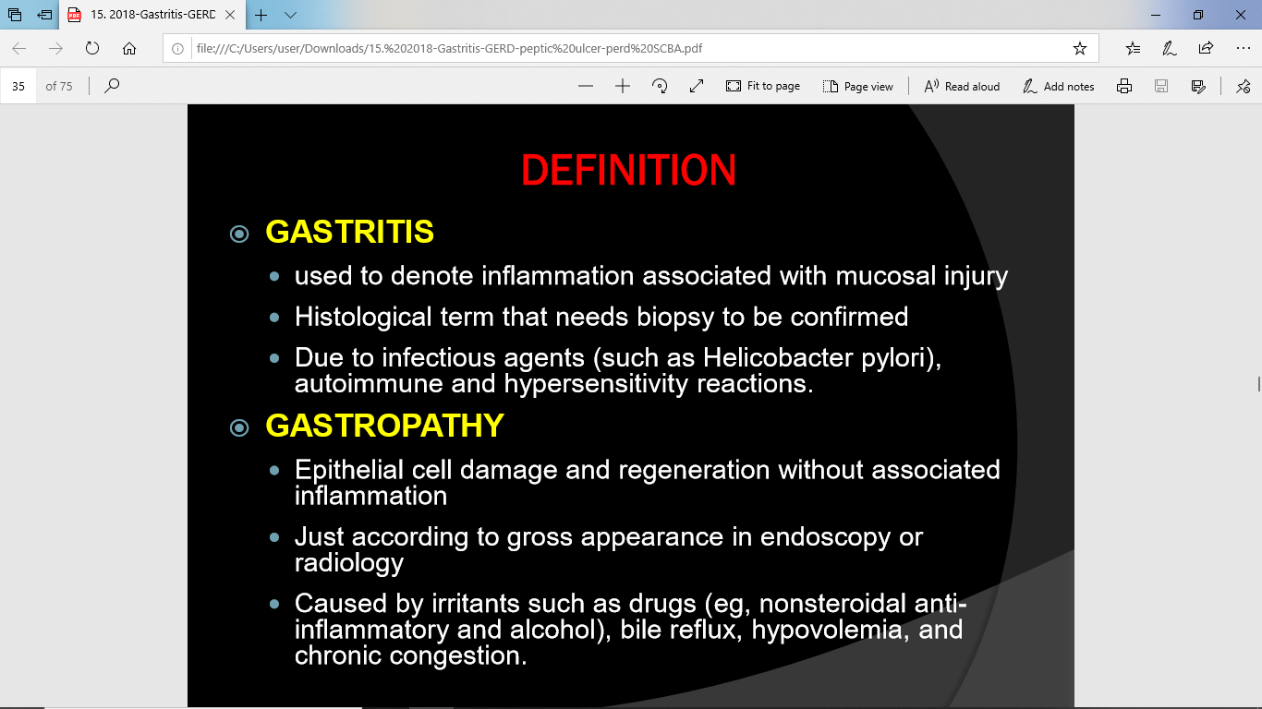

Slide 3
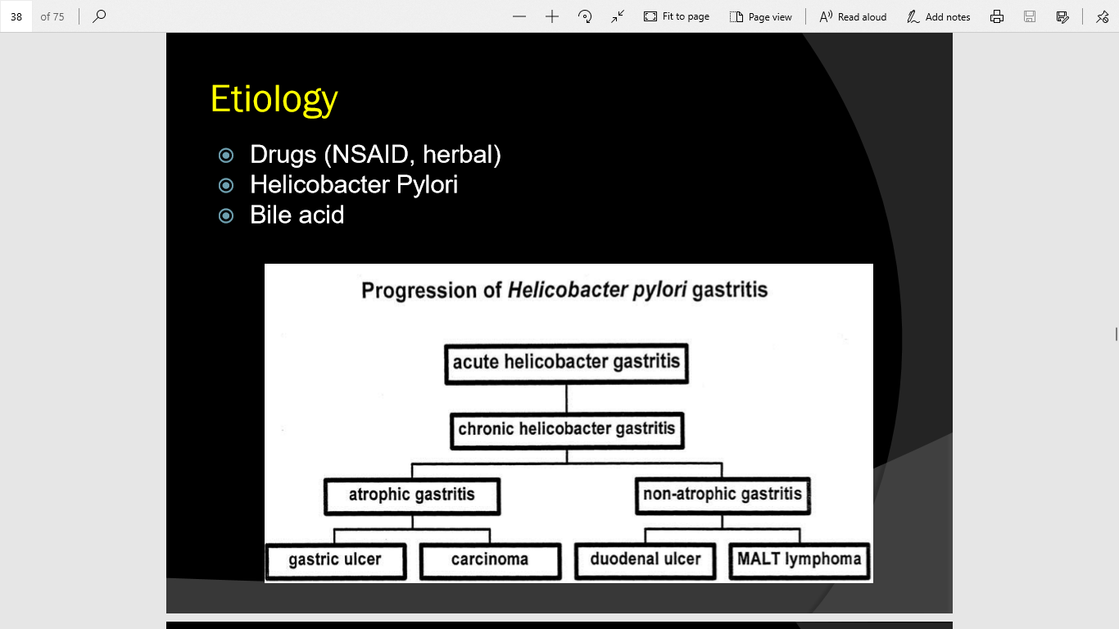

Slide 4
Classification
Acute
  Short term inflammation
  Histology: neutrophilic infiltrate
Chronic
  Long standing forms
  Histology : mononuclear cell infiltrate especially lymphocyte and maccrophages

Slide 5
Pathophysiology
The mechanisms of mucosal injury in gastritis are thought to be an imbalance of
aggressive factors
acid production or pepsin
and defensive factors
mucus production
bicarbonate
and blood flow

Slide 6
“IMBALANCE”
FAKTOR AGRESIF
FAKTOR DEFENSIF
Robbins.Pathology Anatomy

Slide 7
Patients typically present with abdominal pain that has the following characteristics
Epigastric to left upper quadrant
Frequently described as burning
May radiate to the back
Usually occurs 1-5 hours after meals
May be relieved by food, antacids (duodenal), or vomiting

Slide 8
Treatment
Drugs:
  Antasida
  Antagonis reseptor H2
  proton pump inhibitor
  Antikolinergic
  Sitoprotektor → sukralfat dan rebamipid
  prostaglandin

Slide 9
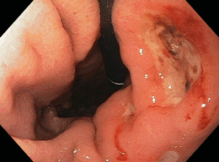
Peptic ulcer
A break in superficial epithelial cells penetrating down to muscularis mucosa

Slide 10
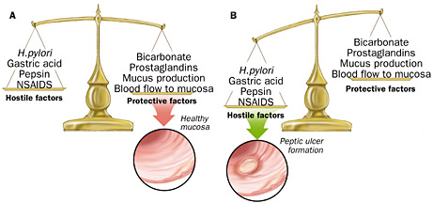
Pathogenesis PUD

Slide 11
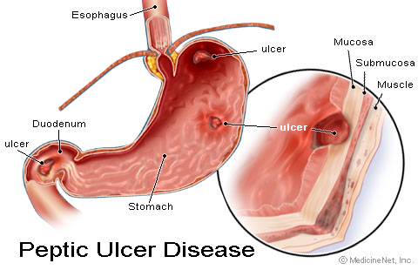
Duodenal vs Gastric
 | DUODENAL | GASTRIC
INCIDENCE | More common | Less common
ANATOMY | First part of duodenum – anterior wall | Lesser curvature of stomach
DURATION | Acute or chronic | Chronic
MALIGNANCY | Rare | Benign or malignant

Slide 12
Duodenal VS gastric
Duodenal ulcers
Gastric ulcers
duodenal sites are 4x as common as gastric sites
most common in middle age
  peak 30-50 years
Male to female ratio—4:1
Genetic link: 3x more common in 1st degree relatives
more common in patients with blood group O
associated with increased serum pepsinogen
H. pylori infection common
  up to 95%
smoking is twice as common
common in late middle age
  incidence increases with age
Male to female ratio—2:1
More common in patients with blood group A
Use of NSAIDs - associated with a three- to four-fold increase in risk of gastric ulcer
Less related to H. pylori than duodenal ulcers – about 80%
10 - 20% of patients with a gastric ulcer have a concomitant duodenal ulcer

Slide 13
Risk factors
HELICOBACTER PYLORI
Non Steroidal Anti-inflammatory Drugs
Steroid therapy
Smoking
Excess alcohol intake
Genetic factors
Zollinger Ellison syndrome – rare syndrome caused by gastrin-secreting tumour
Blood group O
Hyperparathyroidism

Slide 14
H Pylori
Urease producing, gram negative bacillus
Developing countries
Infection increases with age
Infects mucosa of stomach → inflammatory response → gastritis → increased gastrin secretion → gastric metaplasia → damage to mucosa → ulceration
Increased risk of developing gastric adenocarcinoma

Slide 15
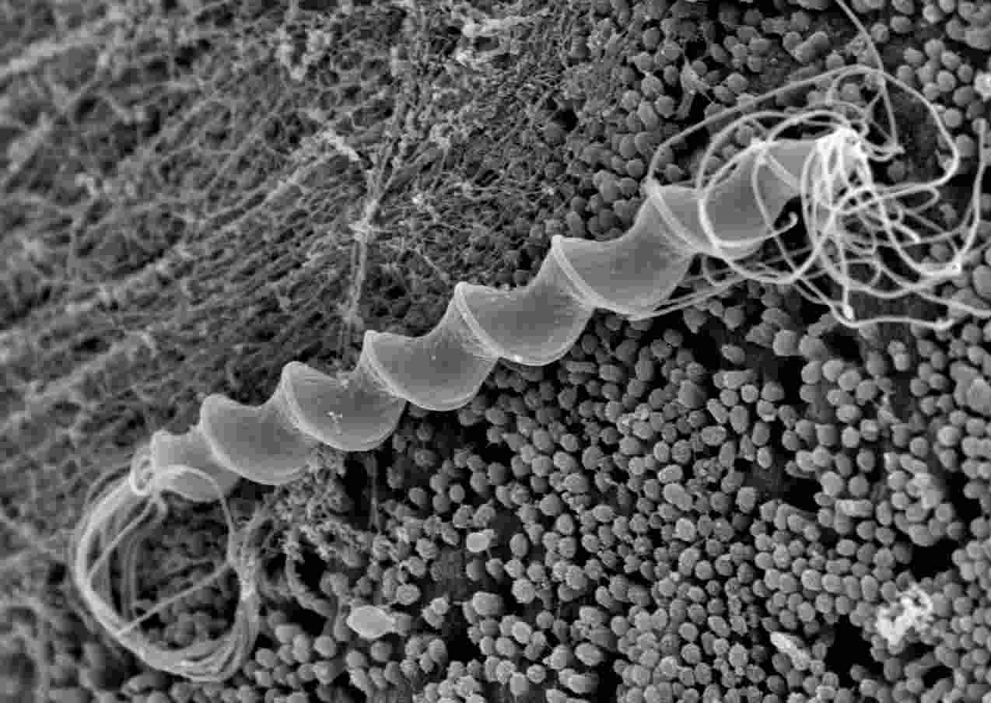
Gram negative, Spiral bacilli
Spirochetes
Do not invade cells – only mucous
Breakdown urea - ammonia
Break down mucosal defense
Chronic Superficial inflammation

Slide 16
Symptoms of PUD
Pain—”gnawing”, “aching”, or “burning”
  Duodenal ulcers: occurs 1-3 hours after a meal and may awaken patient from sleep. Pain is relieved by food, antacids, or vomiting.
  Gastric ulcers: food may exacerbate the pain while vomiting relieves it.
Nausea, vomiting, belching, dyspepsia, bloating, chest discomfort, anorexia, hematemesis, &/or melena may also occur.
  nausea, vomiting, & weight loss more common with Gastric ulcers

Slide 17
ALARM signs for epigastric pain
Chronic GI bleeding
Iron-deficiency anaemia
Progressive unintentional weight loss
Progressive dysphagia
Persistent vomiting
Epigastric mass
Patients aged 55 years and older with unexplained and persistent recent- onset dyspepsia alone

Slide 18
PUD DIAGNOSIS
Endoscopy
Barium meal – contrast x-ray
Biopsy – bacteria & malignancy
H.Pylori:
  Endoscopy cytology
  Biopsy – Special stains
  Culture - difficult
  Urease Breath test.
  Stool antigen test

Slide 19
Drugs used
to treat PUD
Antimicrobial
Agents
Amoxicillin
Bismuth
Clarithromycin
Metronidazole
Tetracycline
H2-Histamine
R Blockade
Cimetidine
Famotidine
Nizatidine
Ranitidine
Prostaglandins
Misoprostol
PPI
Lansoprazole
Omeprazole
Esomeprazole
pantoprazole
Antimuscarinic
Agents
Pirenzepine
Antacids
Al(OH)3
[Mg(OH)2]
CaCO3
Mucosal
Protective
Agents
Bismuth
Sulcralfate

Slide 20
Treatment Plan: H. Pylori
Medications: Triple therapy for 14 days is considered the treatment of choice.
  Proton Pump Inhibitor + clarithromycin and amoxicillin
    Omeprazole (Prilosec): 20 mg PO bid for 14 d or
    Lansoprazole (Prevacid): 30 mg PO bid for 14 d or
    Rabeprazole (Aciphex): 20 mg PO bid for 14 d or
    Esomeprazole (Nexium): 40 mg PO qd for 14 d plus
    Clarithromycin (Biaxin): 500 mg PO bid for 14 and
    Amoxicillin (Amoxil): 1 g PO bid for 14 d
    Can substitute Flagyl 500 mg PO bid for 14 d if allergic to PCN
  In the setting of an active ulcer, continue qd proton pump inhibitor therapy for additional 2 weeks.
Notes:
Want a 50-60% improvement in ulcer.

Slide 21
Treatment Plan: Not H. Pylori
Medications—treat with Proton Pump Inhibitors or H2 receptor antagonists to assist ulcer healing
  H2: Tagament, Pepcid, Axid, or Zantac for up to 8 weeks
  PPI: Prilosec, Prevacid, Nexium, Protonix, or Aciphex for 4-8 weeks.

Slide 22
Lifestyle Changes
Discontinue NSAIDs and use Acetaminophen for pain control if possible.
Acid suppression--Antacids
Smoking cessation
No dietary restrictions unless certain foods are associated with problems.
Alcohol in moderation
  Men under 65: 2 drinks/day
  Men over 65 and all women: 1 drink/day
Stress reduction

Slide 23
Complications
Perforation & Penetration—into pancreas, liver and retroperitoneal space
Peritonitis
Bowel obstruction, Gastric outflow obstruction, & Pyloric stenosis
Bleeding--occurs in 25% to 33% of cases and accounts for 25% of ulcer deaths.
Gastric CA

Slide 24
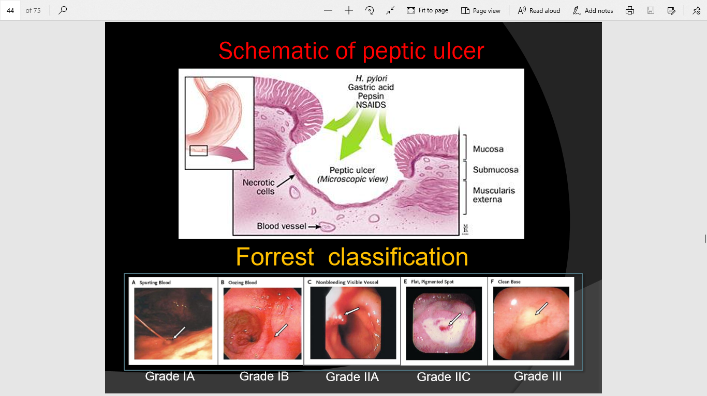

Slide 25
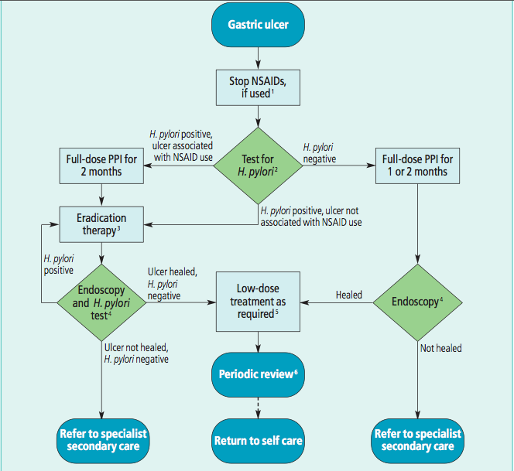

Slide 26
