Slide 1
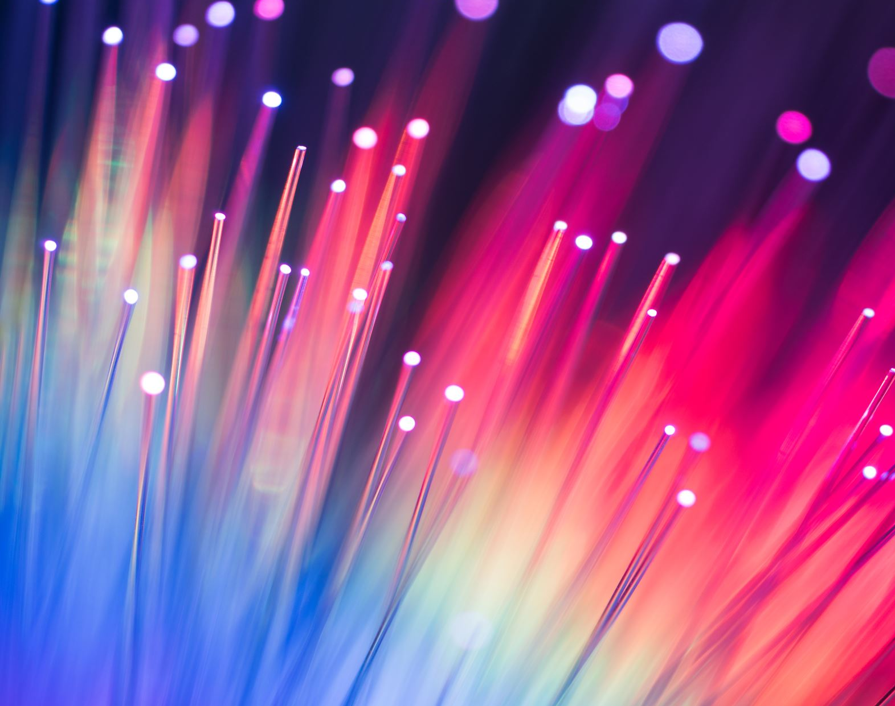
Image Fundamentals
AI004 – Yufis Azhar – UMM

Slide 2
Pixels: The Building Blocks of Images
Pixels are the raw building blocks of an image. Every image consists of a set of pixels. There is no ﬁner granularity than the pixel.
Normally, a pixel is considered the “color” or the “intensity” of light that appears in a given place in our image. If we think of an image as a grid, each square contains a single pixel

Slide 3
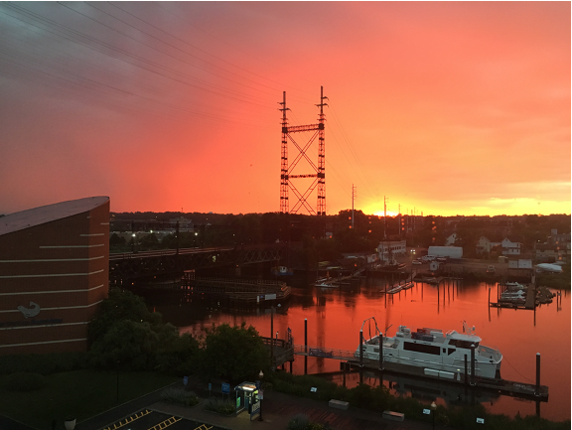
Pixels: The Building Blocks of Images
This image has a resolution of 1.000 x 750, meaning that it is 1.000 pixels wide and 750 pixels tall
We can conceptualize an image as a (multidimensional) matrix
In this case, our matrix has 1.000 columns (the width) with 750 rows (the height)
750
1.000

Slide 4
Grayscale Pixel
Most pixels are represented in two ways:
Grayscale / Single channel
Color
In a grayscale image, each pixel is a scalar value between 0 and 255, where zero corresponds to “black” and 255 being “white”
Values between 0 and 255 are varying shades of gray, where values closer to 0 are darker and values closer to 255 are lighter

Slide 5
Color Pixel
Color pixels; however, are normally represented in the RGB color space
Pixels in the RGB color space are no longer a scalar value like in a grayscale/single channel image
Instead, the pixels are represented by a list of three values: one value for the Red component, one for Green, and another for Blue
To deﬁne a color in the RGB color model, all we need to do is deﬁne the amount of Red, Green, and Blue contained in a single pixel
Each Red, Green, and Blue channel can have values deﬁned in the range [0; 255] for a total of 256 “shades”, where 0 indicates no representation and 255 demonstrates full representation
The RGB color space is additive. The more red, green and blue you mix together, the closer you get to white

Slide 6
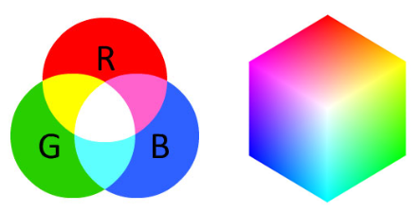
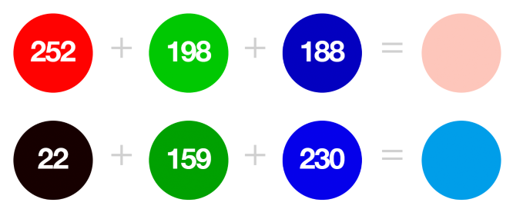
Color Pixel

Slide 7
Forming an Image From Channels
We can conceptualize an RGB image as consisting of three independent matrices of width W and height H, one for each of the RGB components
We can combine these three matrices to obtain a multi-dimensional array with shape W x H x D where D is the depth or number of channels (for the RGB color space, D=3)

Slide 8
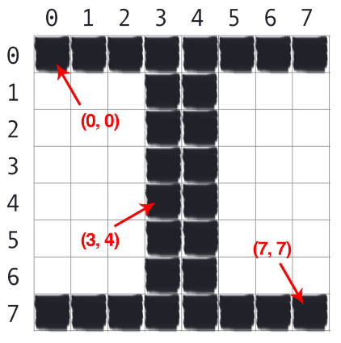
The Image Coordinate System
The letter “I” placed on a piece of graph paper. Pixels are accessed by their (x, y) coordinates, where we go x columns to the right and y rows down, keeping in mind that Python is zero-indexed.

Slide 9
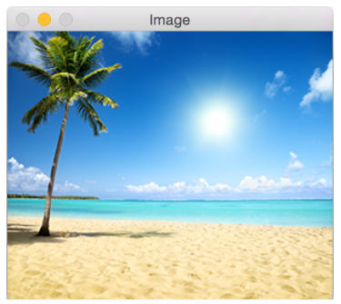
Images as Numpy Array
Image processing libraries such as OpenCV and scikit-image represent RGB images as multidimensional NumPy arrays with shape (height, width, depth)
248
300

Slide 10
RGB and BGR Ordering
It’s important to note that OpenCV stores RGB channels in reverse order. While we normally think in terms of Red, Green, and Blue, OpenCV actually stores the pixel values in Blue, Green, Red order.

Slide 11
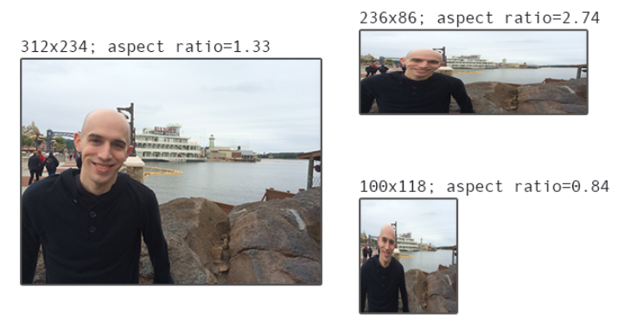
Scaling and Aspect Ratios
Scaling, or simply resizing, is the process of increasing or decreasing the size of an image in terms of width and height
When resizing an image, it’s important to keep in mind the aspect ratio, which is the ratio of the width to the height of the image
Ignoring the aspect ratio can lead to images that look compressed and distorted

Slide 12
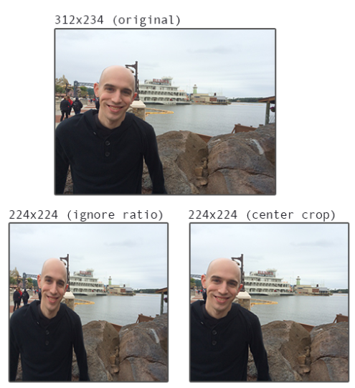
Scaling and Aspect Ratios
Top: Our original input image
Bottom left: Resizing an image to 224 x 224 pixels by ignoring the aspect ratio
Bottom right: Resizing an image 224 x 224 pixels by ﬁrst resizing along the shortest dimension and then taking the center crop.

Slide 13
Let’s make our hands dirty! Move to google colab!

