Slide 1
Evaluating in Image Retrieval

Slide 2
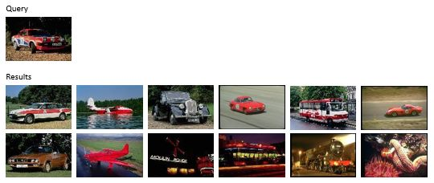
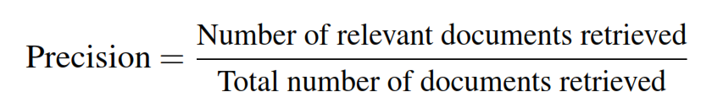

Precision
$$Precision=\frac{6}{12}=0.5$$

Slide 3
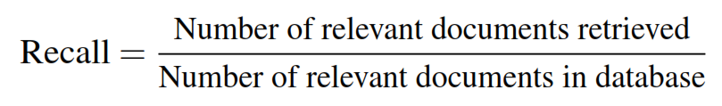

Recall
*diasumsikan terdapat 36 gambar mobil di dataset
$$Recall=\frac{6}{36}=0.17$$

Slide 4

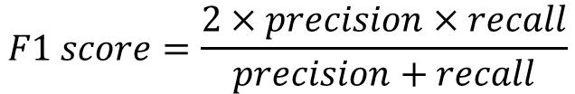
F1-score
$$F1 score=\frac{2×precision×recall}{precision+recall}$$
$$F1 score=\frac{2×0.5×0.17}{0.5+0.17}=\frac{0.17}{0.67}=0.254$$

Slide 5
Precision better than recall for retrieval system

